Slide 1

Assertions
Assertions help us to verify and ensure that testing process is going in a right direction and the server which is under test returns the expected results.
Prepared By: Poojitha.M

Slide 2
Assertions
Concept of Assertions
when user sends requests to the server and wait for the response, after a long wait when user gets response then how user will be ensure that the coming response from the server is the correct one.
To resolve this issue, use assertion or verification to ensure that the response comes from server at run time is correct, if the response will be not correct then test will get fail for that request.

Slide 3
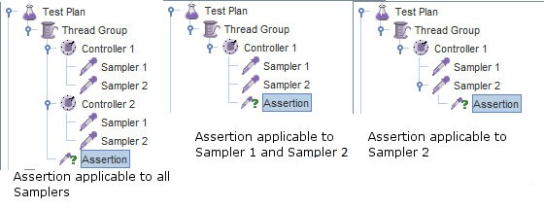
Assertions
Concept of Assertions
Assertions applied to the parent element of test plan tree available to its child elements. When it is applied to child elements, it becomes more specific and will not be available to parent element but will be available to its children.

Slide 4
Assertions
Types of Assertions
Response Assertion
Duration Assertion
Size Assertion
XML Assertion
HTML Assertion

Slide 5
Assertions
Response Assertion
Response assertion is the most commonly used assertion which is used to check whether the response text/body/code/message/headers contain, match or equal a specified pattern.
You can also provide negative assertion like if the pattern ‘does not match’ the response. The assertion can be made negative by checking the Not field.

Slide 6

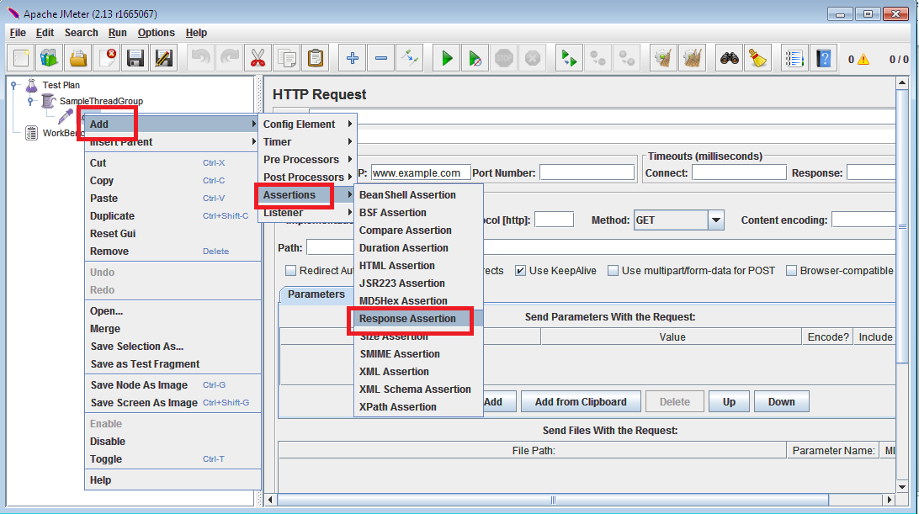
Assertions Response Assertion
Consider an example of sending a request to a website and wait for the server response. In this case, Response Assertion role is to verify that the server response has probable pattern string, e.g. “Login” or not.
Step 1: Add a Response assertion to a Login sampler in our test plan as shown in the below figure.

Slide 7
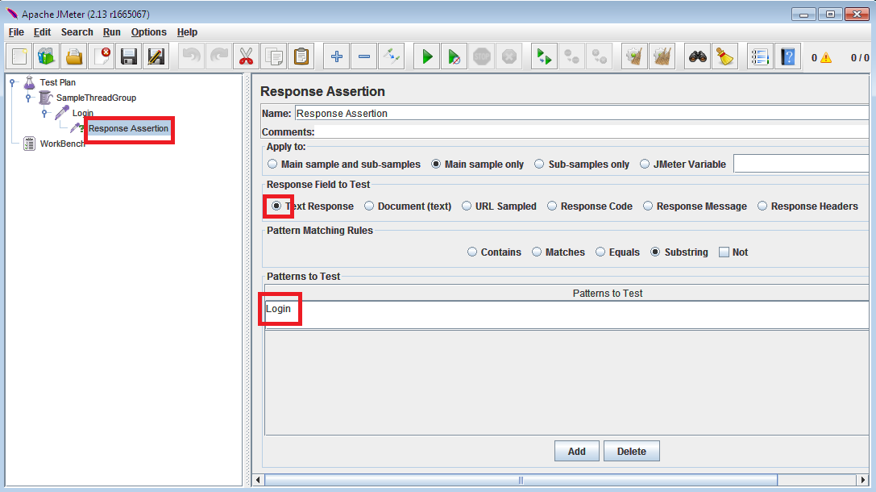
Assertions
Response Assertion
Step 2: Now add pattern to text (ex: Login) as shown in the below figure

Slide 8
Assertions
Size Assertion
Size Assertion in JMeter is used to test that each response comes from server holds the expected number of byte.
It facilitates users to specify the size i.e. equal to, greater than, less than or not equal to a given number of bytes.

Slide 9
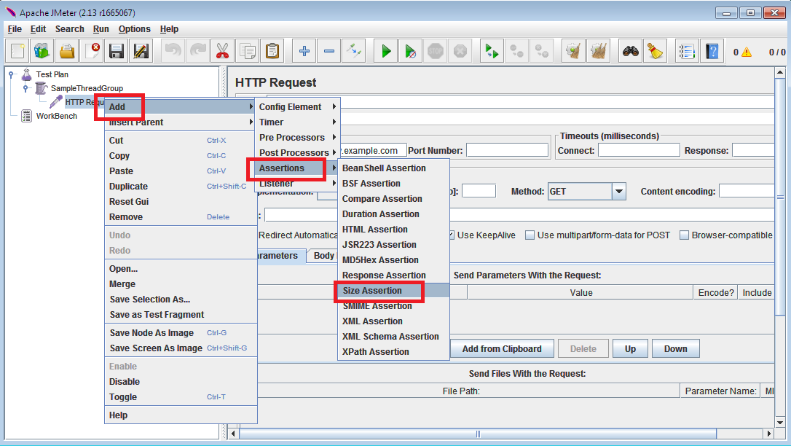
Assertions
Size Assertion
Consider a example if someone sends request to a website (www.example.com) by JMeter and receives response packet with less than expected byte(5000bytes) in size then a test case will pass or that case will fail.
Step 1: Add a Size assertion to sampler as shown below:

Slide 10
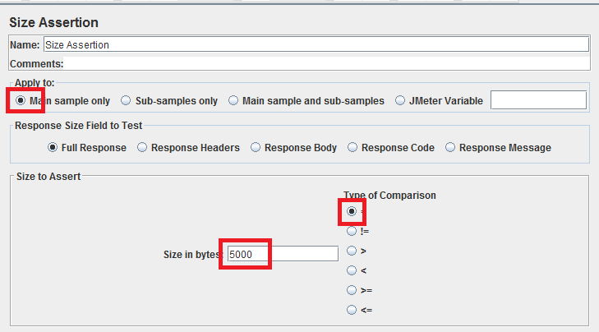
Assertions
Size Assertion
Step 2:Open the size assertion and specify the required no. of bytes at size in bytes field as shown below

Slide 11
Assertions
Duration Assertion
Duration Assertion in JMeter is used to test that each response comes from server has received within a given amount of time or not.
If any server response takes longer time than the given number of milliseconds specified by the user then the response gets fail.

Slide 12
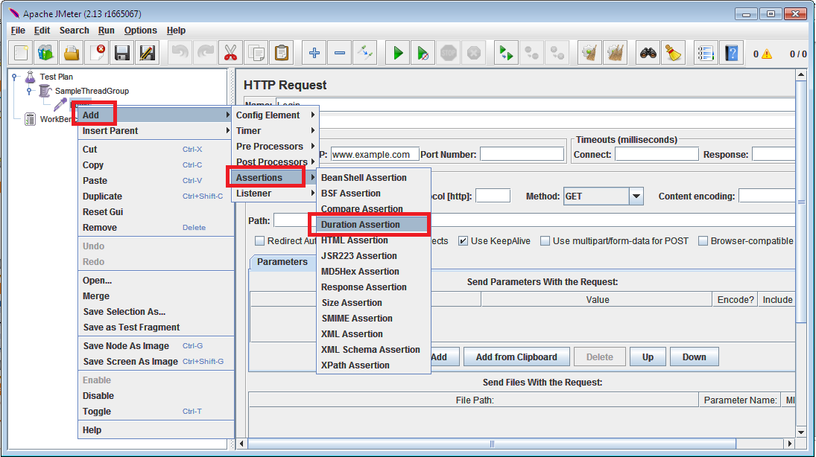
Assertions
Duration Assertion
Consider an example of using a duration assertion in testing a Login page by specifying number of milliseconds as 1500ms, If response takes longer time than the specified number of milliseconds then the response gets fail.
Step 1: Add a duration assertion to the login sampler as shown in the below figure

Slide 13
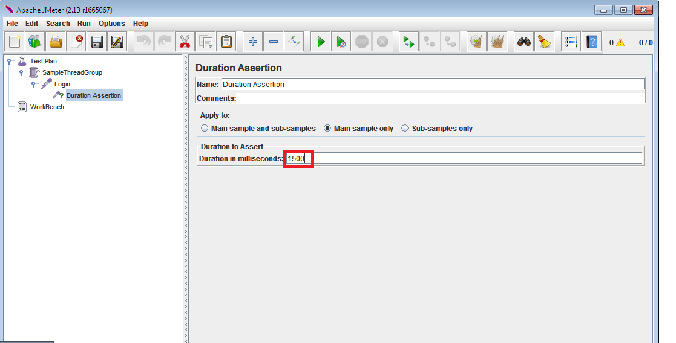
Assertions
Duration Assertion
Step 2: Now specify the required number of milliseconds as shown in the below figure

Slide 14
Assertions
Duration Assertion
Finally after adding the required assertion in our test plan, need to add a Listener to view the result (Pass/Fail) of that assertion.

Slide 15

Thank You

